Slide 1

RECIPE MANAGEMENT SYSTEM
For milling operation
Presenter > GAURAV KUMAR JHA

Slide 2
Project Vision Core Objective
To implement robust, secure and user-friendly recipe management system to eliminate errors in recipe handling
Develop a zero-error system for validating and approving recipe with strict access and audit control

Slide 3
Project Phases:
PHASE BREAKDOWN
PLANNING & DESIGN
FRONTEND DEVELOPMENT
DEPLOYMENT
Finalize requirement, UI/UX design, and CSV structure.
Create recipe editor UI, integrate backend functionality, and develop login interface.
Deploy the functional prototype
01
02
03
04
05
BACKEND DEVELOPMENT
TESTING & QA
Set up project structure, develop CSV modules, and implement authentication.
Conduct unit and integration testing, followed by User Acceptance Testing.

Slide 4
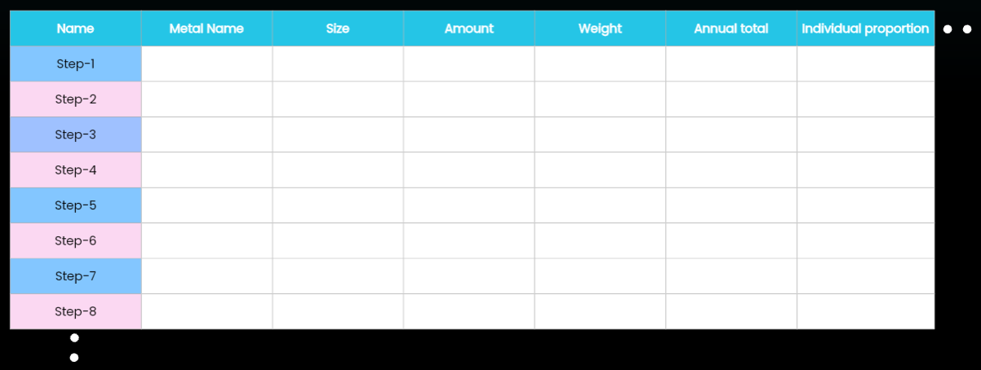
Core System Requirement
RECIPE STRUCTURE
Features 50 columns with configurable limits and 100 rows conditions from operational steps
Implement a multi-level approval system for recipe submission and validation
INTERLOCKS & VALIDATION
APPROVAL WORKFLOW
Enforce row-cell validation and conditional save rules to maintain recipe integrity

Slide 5
Detailed Feature
INTERLOCKS & REAL-TIME VALIDATION
Logic ensures all row conditions are met before saving with user feedback on errors
01
02
03
RECIPE DEFINITION & STRUCTURE
APPROVAL WORKFLOW
Dynamic recipe grid with real/Boolean inputs and clear parameter mapping
Multi-tiered approval process with roles defined for Operator, Supervisor, and Engineer

Slide 6
User Access & Security
ACCESS LEVEL
ROLES ^ RESPONSIBILITIES
AUTHENTICATION
AUDIT LOGS
Operators create/edit; Supervisor and Engineer approve/reject recipe accordingly
Secure login with user roles managed through an Admin interface
All critical user actions are logged for accountability

Slide 7
Technical Architecture
SYSTEM COMPONENTS
Frontend handles user interactions;
Backend manages data processing

Slide 8
Technical & Software Requirements
BACKEND REQUIREMENTS
FRONTEND REQUIREMENT
PROFRAMMING LANG. & FRAMEWORK
Python, Java, React, along with their respective frameworks
Options for Desktop utilizing suitable framework and UI technologies
DATA STORAGE
Recipe maintained in secure CSV files with encrypted user credentials and logs.

Slide 9
Q
A
&

